Slide 1
FORECASTING AT 3M REGARDING PERSONAL PROTECTIVE EQUIPMENT (PPE)
Institution
Presenter’s Name

Slide 2
Definition of Forecasting
Forecasting is a technique that uses historical data as inputs to make informed estimates that are predictive in determining the direction of future trends.
Therefore, forecasting involves such as:
  Planning the planning for the budget
  Predicting the likely amount of expenses
  Projecting the likely outcomes for products, etc.
  Predicting future outcomes.
  Analyzing the past events and using it to project the future.

Slide 3
Types of Forecasting
Forecasting takes two forms or types.
Judgement forecasting-This depends on the human mind and intuition to connect dots from the past to predict the future. Since the human brain is used, this type of forecasting deals with limited amounts of data.
Quantitative forecasting-This uses data analytics to analyze historical amounts of data quantitatively to discern trends and therefore predict the future.
Quantitative forecasting is free from bias.

Slide 4
The Forecast Regarding PPE at 3M
The demand for PPE is set to increase from the $30.48 billion that was in the year 2018, to about $60 billion by the year 2024.
Increase in demand can be attributed to COVID-19
Australian fires have also reminded people that they need PPE hence the demand
The growing construction industry also requires people to use protective wearables.

Slide 5
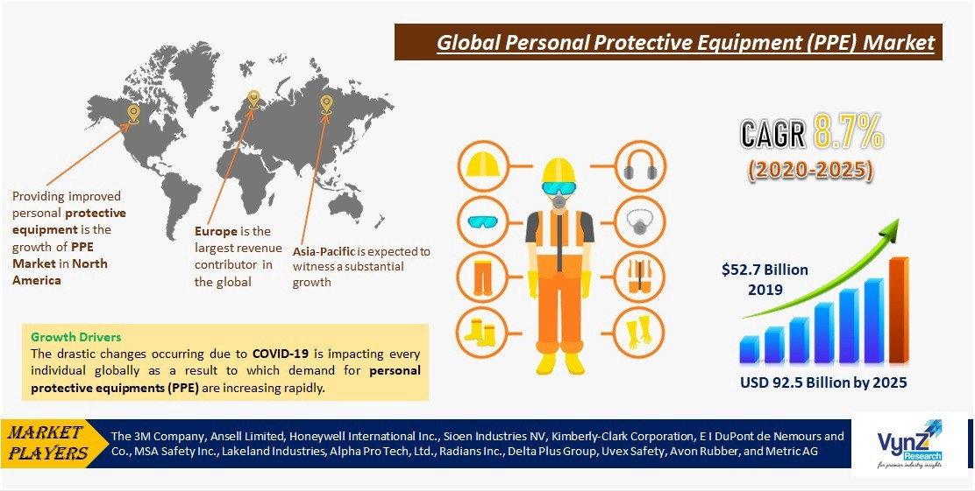
Forecasting PPE Demand Globally and at 3M

Slide 6
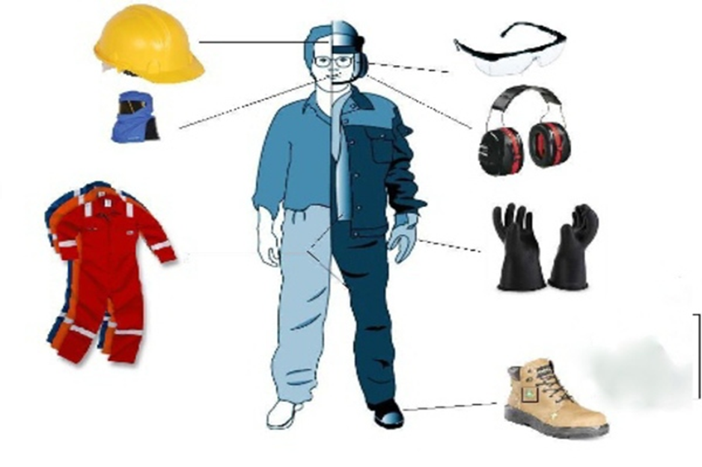
Personal Protective Equipment Needed
Personal Protective Equipment come in varieties depending on their functions as shown in the picture.
Footwear
Eye protective wear
Gloves
Helmets
Overalls

